Slide 1
Information Security
Digital Signatures
Lecture 12
Dr. Amir Mehmood

Slide 2
Digital Signatures
Digital Signatures are used to “Sign” messages to validate the source and integrity of the contents.
AC10F1AB38

Slide 3
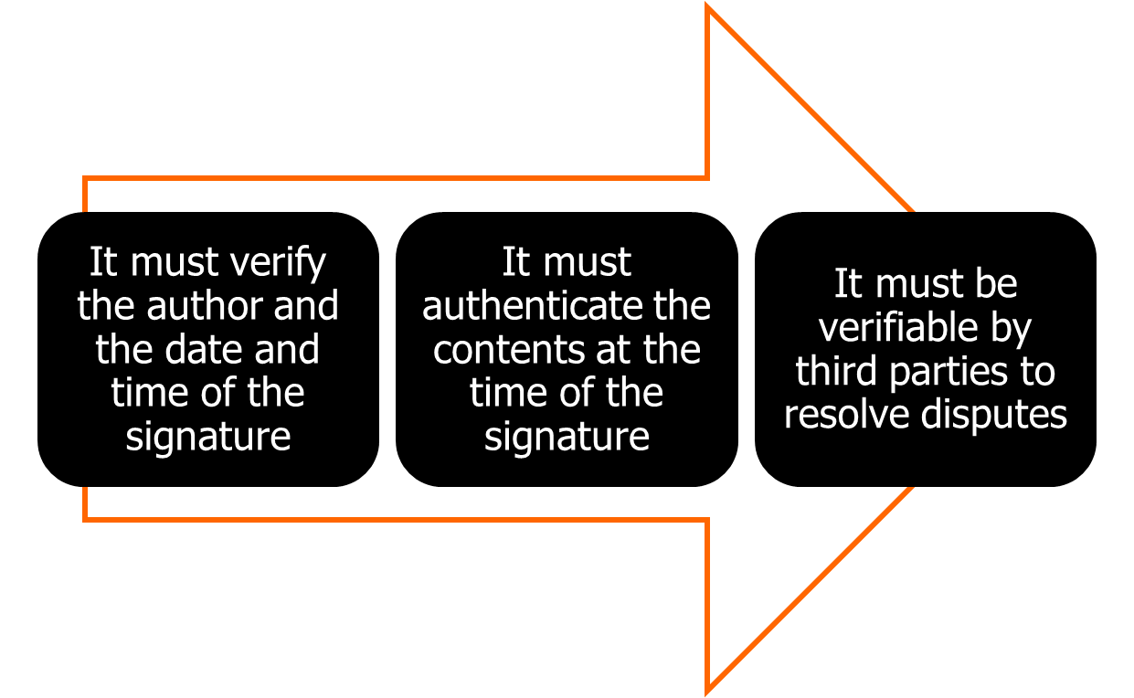
Digital Signature Properties
© 2017 Pearson Education, Ltd., All rights reserved.
Notes:
Message authentication protects two parties who exchange messages from any third
party. However, it does not protect the two parties against each other. Several forms
of dispute between the two are possible.
In situations where there is not complete trust between sender and receiver,
something more than authentication is needed. The most attractive solution to
this problem is the digital signature. The digital signature must have the following
properties:
• It must verify the author and the date and time of the signature.
• It must authenticate the contents at the time of the signature.
• It must be verifiable by third parties to resolve disputes.
Thus, the digital signature function includes the authentication function.

Slide 4
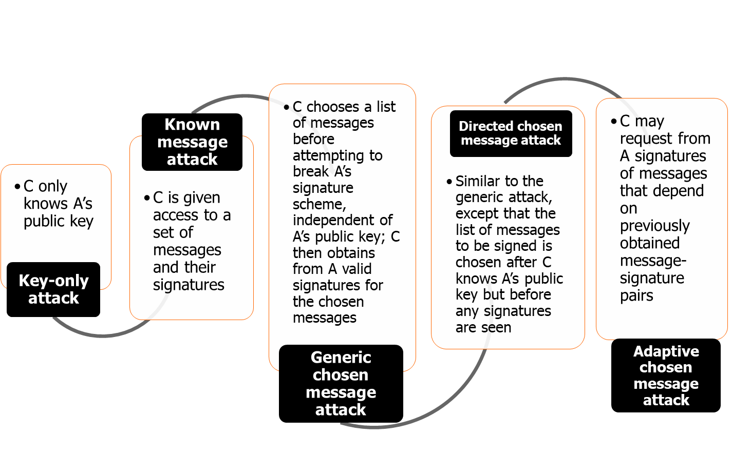
Attacks
© 2017 Pearson Education, Ltd., All rights reserved.
Notes:
[GOLD88] lists the following types of attacks, in order of increasing severity. Here
A denotes the user whose signature method is being attacked, and C denotes the
attacker.
• Key-only attack: C only knows A’s public key.
• Known message attack: C is given access to a set of messages and their
signatures.
• Generic chosen message attack: C chooses a list of messages before attempting
to breaks A’s signature scheme, independent of A’s public key. C then
obtains from A valid signatures for the chosen messages. The attack is generic,
because it does not depend on A’s public key; the same attack is used against
everyone.
• Directed chosen message attack: Similar to the generic attack, except that the
list of messages to be signed is chosen after C knows A’s public key but before
any signatures are seen.
• Adaptive chosen message attack: C is allowed to use A as an “oracle.” This
means that C may request from A signatures of messages that depend on previously
obtained message-signature pairs.

Slide 5
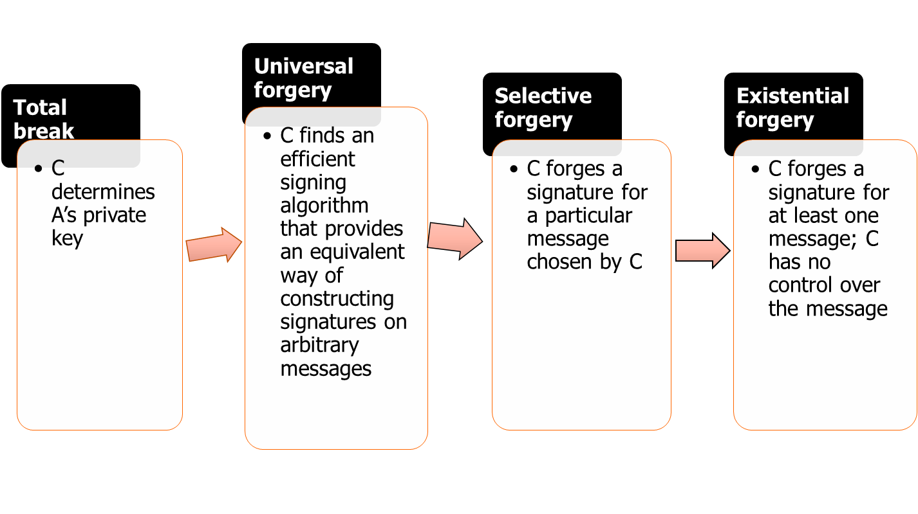
Forgeries
© 2017 Pearson Education, Ltd., All rights reserved.
Notes:
[GOLD88] then defines success at breaking a signature scheme as an outcome
in which C can do any of the following with a non-negligible probability:
• Total break: C determines A’s private key.
• Universal forgery: C finds an efficient signing algorithm that provides an
equivalent way of constructing signatures on arbitrary messages.
• Selective forgery: C forges a signature for a particular message chosen by C.
• Existential forgery: C forges a signature for at least one message. C has no
control over the message. Consequently, this forgery may only be a minor nuisance
to A.

Slide 6
Digital Signature Requirements
The signature must be a bit pattern that depends on the message being signed
The signature must use some information unique to the sender to prevent both forgery and denial
It must be relatively easy to produce the digital signature
It must be relatively easy to recognize and verify the digital signature
It must be computationally infeasible to forge a digital signature, either by constructing a new message for an existing digital signature or by constructing a fraudulent digital signature for a given message
It must be practical to retain a copy of the digital signature in storage
© 2017 Pearson Education, Ltd., All rights reserved.
Notes:
On the basis of the properties and attacks just discussed, we can formulate the following
requirements for a digital signature.
• The signature must be a bit pattern that depends on the message being signed.
• The signature must use some information unique to the sender to prevent
both forgery and denial.
• It must be relatively easy to produce the digital signature.
• It must be relatively easy to recognize and verify the digital signature.
• It must be computationally infeasible to forge a digital signature, either by
constructing a new message for an existing digital signature or by constructing
a fraudulent digital signature for a given message.
• It must be practical to retain a copy of the digital signature in storage.
A secure hash function, embedded in a scheme such as that of Figure 13.2, provides
a basis for satisfying these requirements. However, care must be taken in the design
of the details of the scheme.

Slide 7
What is a digital signature?
A digital signature is a kind of ID. You can use it on the Internet to identify yourself in a secure manner. This is extremely useful in areas such as electronic commerce. For instance, when making a credit card purchase on the Internet, you can use your digital signature to "sign" that purchase. This helps to ensure that only you can make purchases with your credit card number.

Slide 8
What is a digital signature?
The term direct digital signature refers to a digital signature scheme that involves only the communicating parties (source, destination). It is assumed that the destination knows the public key of the source.
A digital signature is a mathematical scheme for verifying the authenticity of digital messages or documents. A digital signature serves three purposes:
Authentication: A digital signature gives a recipient reason to believe that the message was created by a known sender.

Slide 9
What is a digital signature?
Non-repudiation: With digital signature, signer cannot successfully claim he/she did not sign a message.
Integrity: A digital signature ensures that the message was not altered in transit.

Slide 10
Digital Signature
Operation is similar to that of the MAC
The hash value of a message is encrypted with a user’s private key
Anyone who knows the user’s public key can verify the integrity of the message
An attacker who wishes to alter the message would need to know the user’s private key
Implications of digital signatures go beyond just message authentication
© 2017 Pearson Education, Ltd., All rights reserved.
Notes:
Another important application, which is similar to the message authentication
Application, is the digital signature . The operation of the digital signature is similar
to that of the MAC. In the case of the digital signature, the hash value of a message
is encrypted with a user’s private key. Anyone who knows the user’s public key
can verify the integrity of the message that is associated with the digital signature.
In this case, an attacker who wishes to alter the message would need to know the
user’s private key. As we shall see in Chapter 14, the implications of digital signatures
go beyond just message authentication.

Slide 11
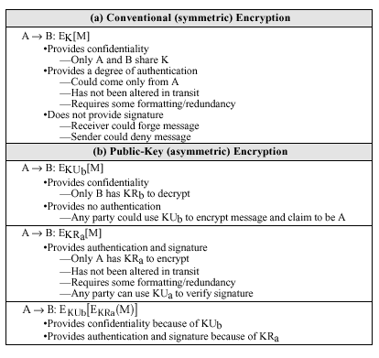
Message Authentication Using Plain Encryption (Recall)

Slide 12
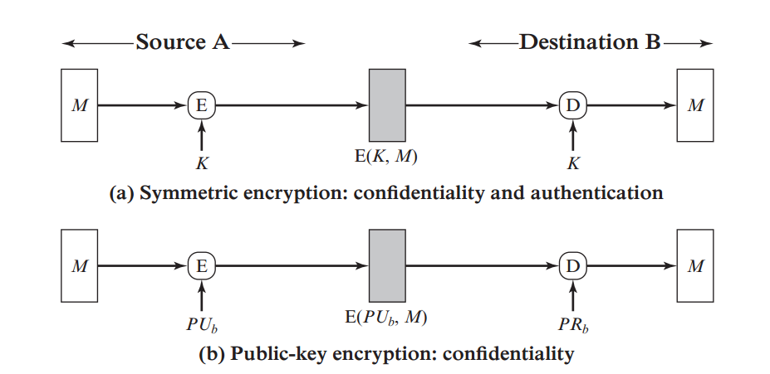
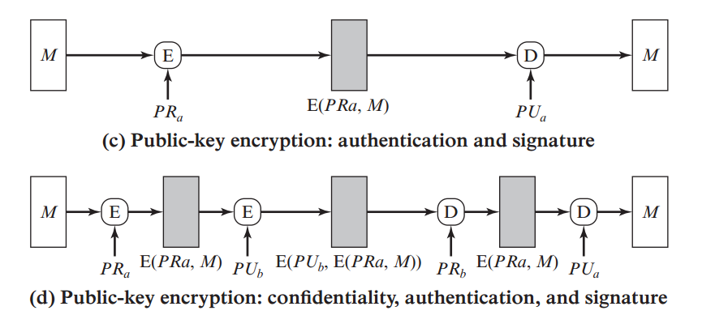
Message Encryption (Recall)

Slide 13
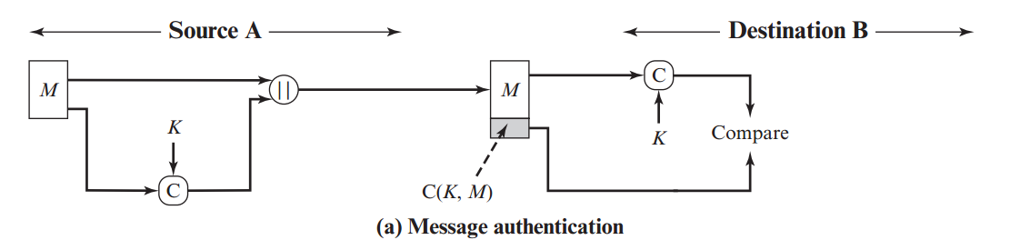
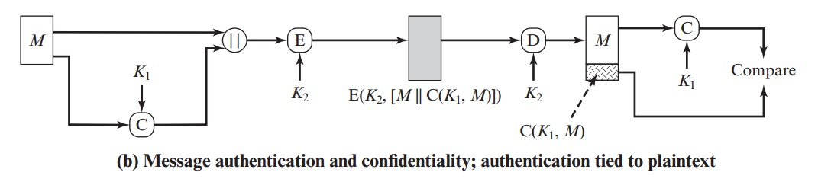
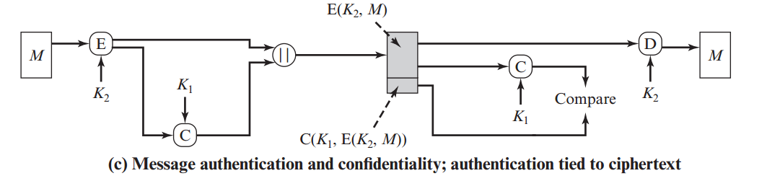
Message Authentication Code (MAC) (Recall)

Slide 14
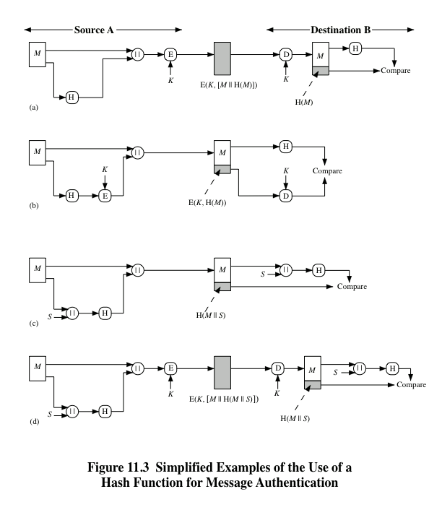
Notes:
Figure 11.3 illustrates a variety of ways in which a hash code can be used to
provide message authentication, as follows:
a. The message plus concatenated hash code is encrypted using symmetric
encryption. Because only A and B share the secret key, the message must
have come from A and has not been altered. The hash code provides the structure
or redundancy required to achieve authentication. Because encryption is
applied to the entire message plus hash code, confidentiality is also provided.
b. Only the hash code is encrypted, using symmetric encryption. This reduces the
processing burden for those applications that do not require confidentiality.
c. It is possible to use a hash function but no encryption for message authentication.
The technique assumes that the two communicating parties share a common secret
value S. A computes the hash value over the concatenation of M and S and
appends the resulting hash value to M. Because B possesses S, it can recompute
the hash value to verify. Because the secret value itself is not sent, an opponent
cannot modify an intercepted message and cannot generate a false message.
d. Confidentiality can be added to the approach of method (c) by encrypting the
entire message plus the hash code.
When confidentiality is not required, method (b) has an advantage over
methods (a) and (d), which encrypts the entire message, in that less computation
is required. Nevertheless, there has been growing interest in techniques that
avoid encryption (Figure 11.3c). Several reasons for this interest are pointed out in
[TSUD92].
• Encryption software is relatively slow. Even though the amount of data to be
encrypted per message is small, there may be a steady stream of messages into
and out of a system.
• Encryption hardware costs are not negligible. Low-cost chip implementations
of DES are available, but the cost adds up if all nodes in a network must have
this capability.
• Encryption hardware is optimized toward large data sizes. For small blocks
of data, a high proportion of the time is spent in initialization/invocation
overhead.
• Encryption algorithms may be covered by patents, and there is a cost associated
with licensing their use.

Slide 15
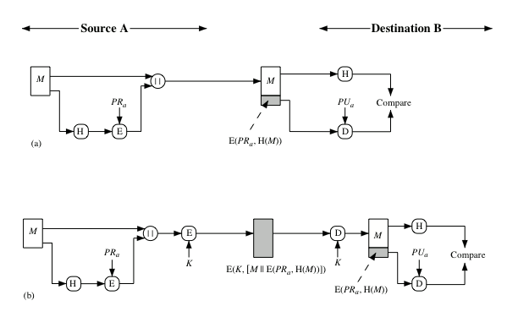

© 2017 Pearson Education, Ltd., All rights reserved.
Notes:
Figure 11.4 illustrates, in a simplified fashion, how a hash code is used to provide
a digital signature.
a. The hash code is encrypted, using public-key encryption with the sender’s private
key. As with Figure 11.3b, this provides authentication. It also provides a
digital signature, because only the sender could have produced the encrypted
hash code. In fact, this is the essence of the digital signature technique.
b. If confidentiality as well as a digital signature is desired, then the message
plus the private-key-encrypted hash code can be encrypted using a symmetric
secret key. This is a common technique.

Slide 16
How is a Digital Signature Produced?
Very briefly, a typical digital signature works like this:
  A signature in the form of a code is generated by applying an algorithm and the sender's private key to message contents.
  The recipient verifies the signature by decrypting it using the sender's public key.

Slide 17
The Idea
Goal - guarantee that message must have originated with certain entity
Idea - encrypt with private key, decrypt with public key
Only owner of the private key could have generated original message

Slide 18
Steps in making a digital signature
Joe runs a one-way hash function to create a fixed length message digest from the message to be sent
Joe encrypts the message digest with his private key to create a digital signature.
Joe sends the signature and the message to Alice
Alice decrypts the signature with Joe’s public key to reveal the message digest
Alice then applies the same one-way function to the message she received from Joe to produce a message digest
Alice compares the message digest she created with the message digest sent by Joe. If they compare the integrity of the messages is verified.

Slide 19
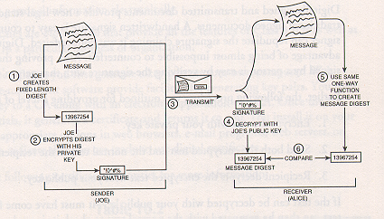
Steps in making a digital signature

Slide 20
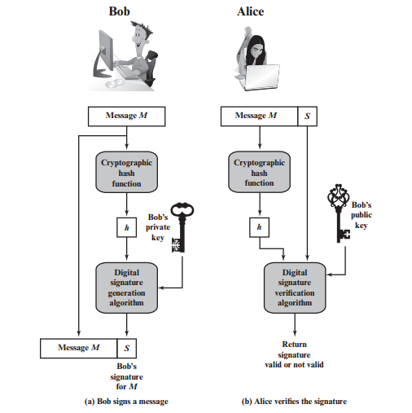
Steps in making a digital signature

Slide 21
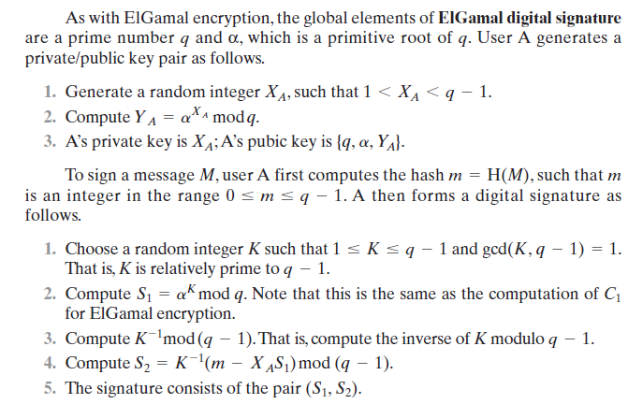
ELGAMAL DIGITAL SIGNATURE SCHEME

Slide 22
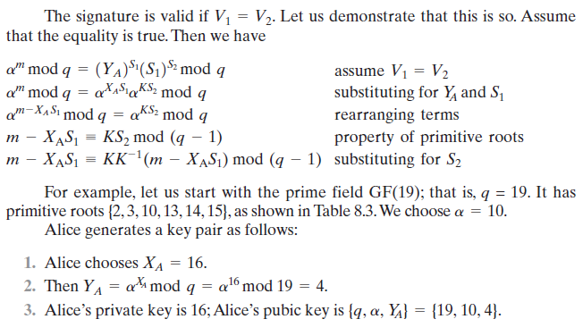
ELGAMAL DIGITAL SIGNATURE SCHEME

Slide 23
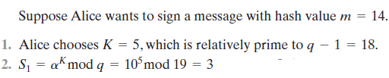
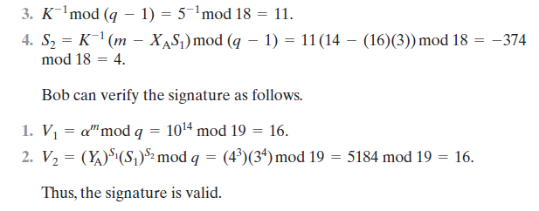
ELGAMAL DIGITAL SIGNATURE SCHEME

Slide 24
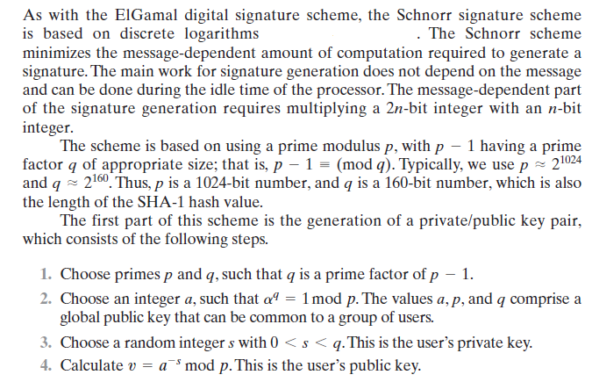
SCHNORR DIGITAL SIGNATURE SCHEME

Slide 25
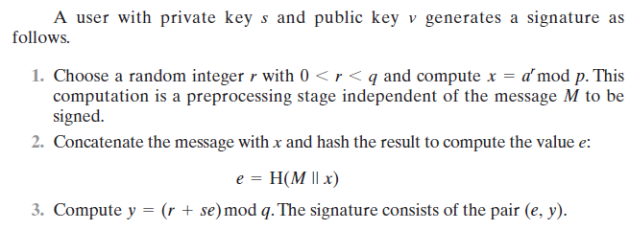
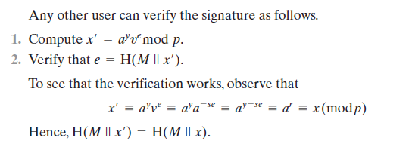
SCHNORR DIGITAL SIGNATURE SCHEME

